Slide 1

TEAM INNOVATRIX
Use Case 16 : Loan Underwriting

Slide 2
How are we still processing loan documents today?
Loan underwriting is done manually. Underwriters look at the borrower’s financial history, credit score, bank statements and about a 20 other documents .
However, this process takes a lot of time, can lead to mistakes, and isn’t easy to scale up when there are many applications.
“These challenges show why a faster, more automated solution is needed."

Slide 3
AI-Powered Loan Underwriting Transformation
01. UnderwriteAI uses Generative AI to automate and enhance loan underwriting.
02. AI-driven analysis of financial records, credit scores, and market trends.
03. Natural Language Processing (NLP) creates human-like summaries and recommendations
Transforming loan underwriting into a faster, more reliable, and scalable process.

Slide 4
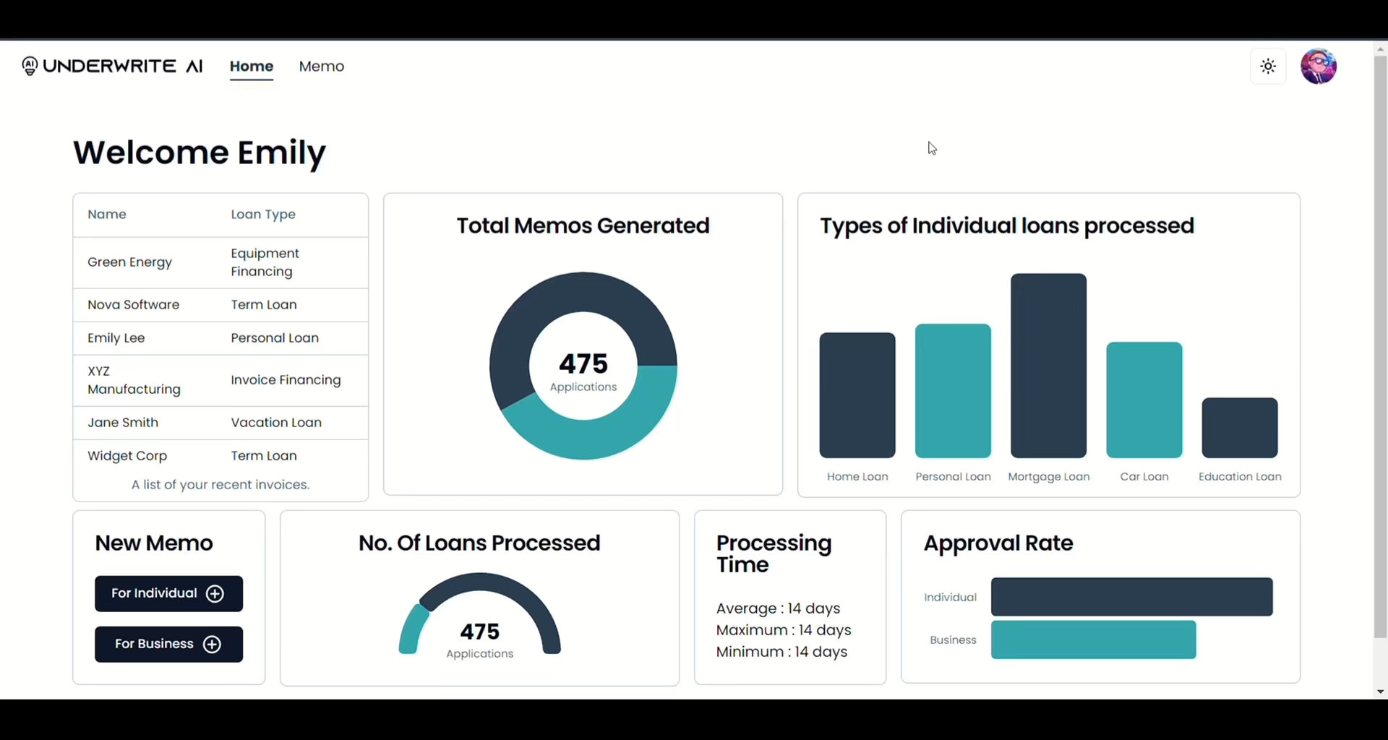
DEMO

Slide 5
Our approach to solution
Generative AI
Data Ingestion
AI Processing
Application Interface
Secure Database
Gather customer data, clean and format it to ensure consistency and accuracy for analysis and processing.
Examine financial data, then create detailed sections of a credit memo, including risk assessments.
Display AI-derived insights clearly to underwriters, aiding their decision-making process with data-driven recommendations.
Safeguard and organize all collected data using robust encryption and secure storage solutions for protection.

Slide 6















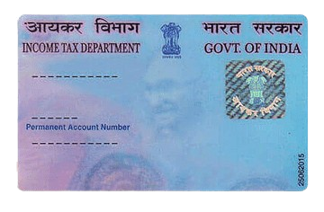




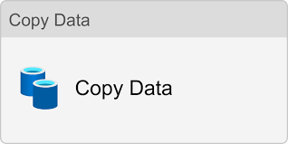



3. Document Integration
4.Lang-chain
Data Store
Personal
Website
Input supporting Document
Business
Vector
Embeddings
Chunks
FAISS
Vector Database
1. Loan Underwriter
Frontend
Backend
9. Azure Data lake storage
5. Prompts
8. Analyse
Responses
10. Security and monitoring
7.Generative AI
Document Verification
Azure Security
Gemini LLM
6. API Data Integration
Aadhar Verification
Azure key vault
Output Dashboard
Input output containers
Pan card tampering
Azure Monitoring
Market News and Stock Price
Azure Data Factory
Pipeline

Slide 7
Creating User Interface of our website
Next.js
Next.js is a React framework for server-side rendering and static site generation with performance optimizations.
01

Slide 8
3. Document Integration
4.Lang-chain
Data Store
Personal
Website
Input supporting Document
Business
Vector
Embeddings
Chunks
FAISS
Vector Database
1. Loan Underwriter
Frontend
Backend
9. Azure Data lake storage
5. Prompts
8. Analyse
Responses
10. Security and monitoring
7.Generative AI
Document Verification
Azure Security
Gemini LLM
6. API Data Integration
Adhar Verification
Azure key vault
Output Dashboard
Input output containers
Pan card tampering
Azure Monitoring
Market News and Stock Price
Azure Data Factory
Pipeline

Slide 9
Streamlit
Streamlit, originally designed for frontend applications, has been effectively transformed into a robust backend system using FastAPI. FastAPI is known for its high performance and asynchronous capabilities, making it an ideal choice for converting Streamlit into a responsive and scalable backend.
How our website function

Slide 10
3. Document Integration
4.Lang-chain
Data Store
Personal
Website
Input supporting Document
Business
Vector
Embeddings
Chunks
FAISS
Vector Database
1. Loan Underwriter
Frontend
Backend
9. Azure Data lake storage
5. Prompts
8. Analyse
Responses
10. Security and monitoring
7.Generative AI
Document Verification
Azure Security
Gemini LLM
6. API Data Integration
Adhar Verification
Azure key vault
Output Dashboard
Input output containers
Pan card tampering
Azure Monitoring
Market News and Stock Price
Azure Data Factory
Pipeline

Slide 11
Data integration & Collection
Data Preprocessing
Data Integration
Cleanses, normalizes, and formats the collected data to ensure consistency and accuracy.
Merges data from disparate systems to create a unified customer profile.
Aggregates customer data from multiple sources such as bank statements, credit reports, financial documents, and application forms.
Real-Time Processing
Data Validation
Enables the ingestion of data in real-time, ensuring the most up-to-date information is available for analysis.
Checks for missing or incorrect data, ensuring the integrity of the information before it moves to the next stage.

Slide 12
3. Document Integration
4.Lang-chain
Data Store
Personal
Website
Input supporting Document
Business
Vector
Embeddings
Chunks
FAISS
Vector Database
1. Loan Underwriter
Frontend
Backend
9. Azure Data lake storage
5. Prompts
8. Analyse
Responses
10. Security and monitoring
7.Generative AI
Document Verification
Azure Security
Gemini LLM
6. API Data Integration
Adhar Verification
Azure key vault
Output Dashboard
Input output containers
Pan card tampering
Azure Monitoring
Market News and Stock Price
Azure Data Factory
Pipeline

Slide 13
4.Lang-chain
Data Store
Personal
Input supporting Document
Vector
Embeddings
Chunks
Business
FAISS
Input supporting Document
Vector Database
Vector
Embeddings
Chunks

Slide 14
3. Document Integration
4.Lang-chain
Data Store
Personal
Website
Input supporting Document
Business
Vector
Embeddings
Chunks
FAISS
Vector Database
1. Loan Underwriter
Frontend
Backend
9. Azure Data lake storage
5. Prompts
8. Analyse
Responses
10. Security and monitoring
7.Generative AI
Document Verification
Azure Security
Gemini LLM
6. API Data Integration
Adhar Verification
Azure key vault
Output Dashboard
Input output containers
Pan card tampering
Azure Monitoring
Market News and Stock Price
Azure Data Factory
Pipeline

Slide 15
Comprehensive Loan Evaluation Prompts
01
Business Loan Prompt:
Emphasizes the automated and thorough evaluation process for business loan applications. It showcases how key financial metrics are used to assess a company's creditworthiness, making the decision-making process more data-driven and less reliant on subjective judgment.
02
Personal Loan Prompt:
Demonstrates the comprehensive analysis of an individual's financial situation, focusing on their ability to manage new debt in the context of existing obligations. This prompt highlights the importance of considering various financial factors, including credit score, spending patterns, and income stability, to ensure responsible lending.

Slide 16
3. Document Integration
4.Lang-chain
Data Store
Personal
Website
Input supporting Document
Business
Vector
Embeddings
Chunks
FAISS
Vector Database
1. Loan Underwriter
Frontend
Backend
9. Azure Data lake storage
5. Prompts
8. Analyse
Responses
10. Security and monitoring
7.Generative AI
Document Verification
Azure Security
Gemini LLM
6. API Data Integration
Adhar Verification
Azure key vault
Output Dashboard
Input output containers
Pan card tampering
Azure Monitoring
Market News and Stock Price
Azure Data Factory
Pipeline

Slide 17
API Integration for market news &
stock data
News Aggregation:
Collects news articles for all companies within each sector using the Finnhub API.
Sentiment Analysis:
Analyzes the aggregated news using the FinBERT model (via the transformers library) to determine overall sector sentiment (positive, negative, neutral).
Stock Price Analysis:
Fetches and averages the current stock prices of all companies in each sector.
Lending Recommendation:
Provides a lending recommendation (Good or Risky) based on average sentiment and stock price.
Investment Prediction:
Projects future stock prices over 5, 10, and 15 years based on current sentiment, offering long-term investment advice.

Slide 18
3. Document Integration
4.Lang-chain
Data Store
Personal
Website
Input supporting Document
Business
Vector
Embeddings
Chunks
FAISS
Vector Database
1. Loan Underwriter
Frontend
Backend
9. Azure Data lake storage
5. Prompts
8. Analyse
Responses
10. Security and monitoring
7.Generative AI
Document Verification
Azure Security
Gemini LLM
6. API Data Integration
Adhar Verification
Azure key vault
Output Dashboard
Input output containers
Pan card tampering
Azure Monitoring
Market News and Stock Price
Azure Data Factory
Pipeline

Slide 19
Integration with
Gemini LLM
We implemented a function that sends an input prompt to the Gemini LLM and retrieves a text-based response. This function is integral to generating the content of credit memos. Credit Memo Generation: For both individual and business loans, I developed prompts that guide Gemini to generate detailed credit memos. These memos include the applicant's financial assessment, risk evaluation, and a final recommendation.

Slide 20
3. Document Integration
4.Lang-chain
Data Store
Personal
Website
Input supporting Document
Business
Vector
Embeddings
Chunks
FAISS
Vector Database
1. Loan Underwriter
Frontend
Backend
9. Azure Data lake storage
5. Prompts
8. Analyse
Responses
10. Security and monitoring
7.Generative AI
Document Verification
Azure Security
Gemini LLM
6. API Data Integration
Adhar Verification
Azure key vault
Output Dashboard
Input output containers
Pan card tampering
Azure Monitoring
Market News and Stock Price
Azure Data Factory
Pipeline

Slide 21

Connecting to Azure storage.
Uploading Data
Why Azure Storage?
Azure Blob Storage is used for storing the generated credit memos and associated files (like PDFs or images). It's a secure and scalable cloud storage solution that ensures all documents are safe and easily accessible.
Setting Up Azure Blob Storage: we set up the connection to Azure using the connection string stored in environment variables. This allows our application to interact securely with the Azure cloud.
Upload_to_azure(): The function is written to handle the storage of files in Azure Blob Storage. Whether it's the generated credit memos or the uploaded loan application PDFs, this function ensures that all data is safely stored.
Save _Json_to_Azure(): This function specifically deals with saving the JSON responses generated by Gemini. It formats the JSON data and uploads it to Azure.

Slide 22
3. Document Integration
4.Lang-chain
Data Store
Personal
Website
Input supporting Document
Business
Vector
Embeddings
Chunks
FAISS
Vector Database
1. Loan Underwriter
Frontend
Backend
9. Azure Data lake storage
5. Prompts
8. Analyse
Responses
10. Security and monitoring
7.Generative AI
Document Verification
Azure Security
Gemini LLM
6. API Data Integration
Adhar Verification
Azure key vault
Output Dashboard
Input output containers
Pan card tampering
Azure Monitoring
Market News and Stock Price
Azure Data Factory
Pipeline

Slide 23
Source
JSON File:
On the left side of the diagram, there is an icon representing a JSON file. This indicates that the source data is in JSON format. Data Movement Activity (Copy Data)
Microsoft Azure
Data Factory
Represented at the top of the diagram as the overarching service managing the entire workflow. Azure Data Factory is used for data integration and transformation tasks, allowing users to move and process data across various sources and destinations.
Destination
CSV File:
On the right side of the diagram, there is an icon representing a CSV file. This indicates that the destination for the data is in CSV format.

Slide 24
3. Document Integration
4.Lang-chain
Data Store
Personal
Website
Input supporting Document
Business
Vector
Embeddings
Chunks
FAISS
Vector Database
1. Loan Underwriter
Frontend
Backend
9. Azure Data lake storage
5. Prompts
8. Analyse
Responses
10. Security and monitoring
7.Generative AI
Document Verification
Azure Security
Gemini LLM
6. API Data Integration
Adhar Verification
Azure key vault
Output Dashboard
Input output containers
Pan card tampering
Azure Monitoring
Market News and Stock Price
Azure Data Factory
Pipeline

Slide 25
Key Vault
01
Safeguards cryptographic keys and secrets for cloud applications.
Azure
Key
Vault &
Monitoring
Integrates with Azure services to control access to sensitive information.
Secure storage for passwords, encryption keys, and certificates.
Azure Monitoring
02
Suite of tools for tracking application and infrastructure performance.
Provides insights into resource availability, performance, and usage.
Includes services like Azure Monitor, Application Insights, and Log Analytics for proactive management and troubleshooting.

Slide 26
3. Document Integration
4.Lang-chain
Data Store
Personal
Website
Input supporting Document
Business
Vector
Embeddings
Chunks
FAISS
Vector Database
1. Loan Underwriter
Frontend
Backend
9. Azure Data lake storage
5. Prompts
8. Analyse
Responses
10. Security and monitoring
7.Generative AI
Document Verification
Azure Security
Gemini LLM
6. API Data Integration
Adhar Verification
Azure key vault
Output Dashboard
Input output containers
Pan card tampering
Azure Monitoring
Market News and Stock Price
Azure Data Factory
Pipeline

Slide 27
Document
Verification
Aadhar card verification and validation
Automates the process of identifying and masking Unique Identification (UID) numbers in images to protect sensitive information. It preprocesses the image, extracts text using OCR, and validates potential UIDs using the Verhoeff algorithm. If no valid UIDs are initially found, the image is enhanced with Super-Resolution to improve text clarity. The script also handles multiple image orientations (0°, 90°, 180°, 270°) to ensure accurate detection. Valid UIDs are then masked by overlaying black rectangles, ensuring privacy in scanned documents.
Pan Card tampering verification
This process detects tampering in PAN card images by comparing the current image with original ones. It involves loading and preprocessing images, aligning them if necessary, and calculating the Structural Similarity Index (SSIM) to measure visual similarity. The tampering percentage is determined based on the SSIM score, with higher percentages indicating potential tampering. Discrepancies are visually highlighted, making it easy to identify altered areas, ensuring the authenticity of the PAN card images.

Slide 28
FUTURE
Financial
Services
Global
Markets
Natural
Language
Processing (NLP)
Potential for
Personalized
Recommendations
Applying the same AI technology to other areas like mortgage underwriting, insurance claims processing, and investment analysis.
Adapting the model to handle regulatory and market differences in various countries.
Integration with Other AI Technologies
Using NLP to further improve the understanding and generation of financial documents.
Leverage user data to deliver tailored recommendations, enhancing customer experience and increasing engagement.

Slide 29

THANK YOU

